Slide 1

Application of Model Predictive Control for Optimal Operation of Wind Turbines
Yuan Yuan, Pei Cao, and Jiong Tang
Mar 27, 2017
SPIE Smart Structures NDE Conference 2017
Department of Mechanical Engineering
University of Connecticut
Storrs, CT, USA
Dynamics, Sensing, and Controls Laboratory
Notes:
Good afternoon everyone; my name is Yuan Yuan, I’m a Ph.D. student at University of Connecticut. The title of my presentation is … this paper is co-authored by myself, pei cao and my advisor prof Jiong tang
1

Slide 2
Outline
Background
Research Objective
Approach
Case Analysis
Concluding Remarks
Notes:
This is an outline of my presentation, first, background, and then research objective,…….

Slide 3
Background: Wind Turbine and Control
Wind Energy
Fastest growing energy source in the world: The worldwide wind capacity reached over 400,000 MW by the end of 2015
Low cost & Renewable
Wind turbine control loops
Generator torque control
Blade pitch control
Nacelle yaw control
http://www.wavege.com/wind-turbine-diagram.html
Notes:
It is well known that wind energy is the fastest ….
It is also low cost and renewable.
One important aspect of wind turbine is the control system. Let’s take a look at the control mechanism of a typical wind turbine.
Wind will produce aerodynamic force and moments to the blade. It will drive rotor to rotate. The generator produces electricity.
There are 3 separate loops here. The first one is ….
In this research I focus on … which are most commonly studied in high wind speeds
//generator change the frequncey

Slide 4
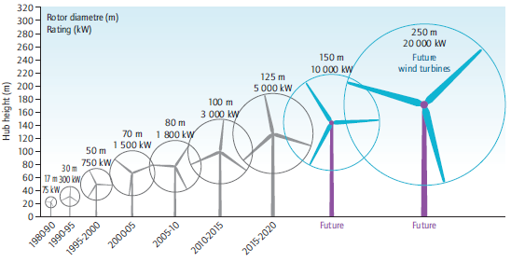


Challenges of Wind Turbine
Source: DOE
Increased turbine size
More frequent maintenance
Time-varying wind speed
The plant dynamics are varying
Reduce overall costs
More power capture
Lower maintenance cost
Notes:
There are some major challenges of wind turbine
One is the increasing turbine size: wind turbines have gotten progressively larger over the past 30 years. It can increase generation capacity and drive down costs. However, the larger size leads to more frequent maintenance.
The second is …….
An important problem in application is that how to reduce overall cost. That is

Slide 5
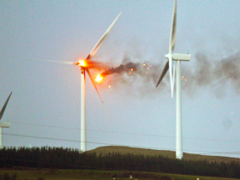
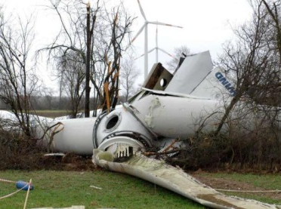
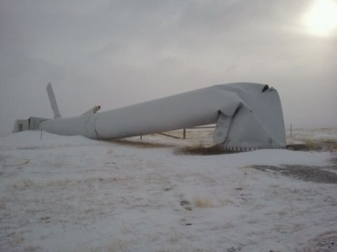
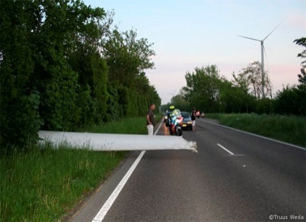
Multiple Objectives in Wind Turbines
Different control goals
Speed control
Power control
Load reduction on blades, tower and drive-train
Prolong actuator life
Challenges of multiple objectives
Designing individual controllers for each objective is getting more and more complex
Conflicting with each other
We need one controller that can balance all the objectives together
Model predictive control:
Online optimization of multiple control objectives
Notes:
To reduce the overall cost, we have several…first we need the speed control to keep the rotor at the rated value when wind speed is very high. If the rotor is over-speed, it will cause the over-heat of the generator and make the turbine on fire as shown in the first figure.
Also we want the power control, to make sure we capture the maximum power from wind when wind speed is not that high.
In addition, we can see there are a lot of components failure, the tower may fall and blade may crack. We need to reduce the loads.
Also, the life of actuators has its limit, changing them too often will increase more costs. So that we need to prolong the actuator life.
However,…..it is quite challenging when we realize multiple objectives
In this research, we choose MPC to achieve the optimization….

Slide 6
Outline
Background
Research Objective
Approach
Case Analysis
Concluding Remarks

Slide 7
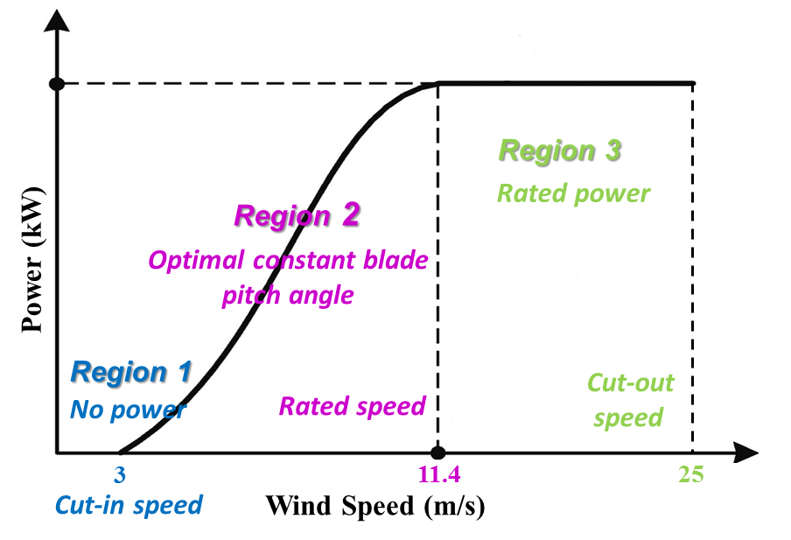
Research Objective
Optimization of multiple objectives in the switching region and Region 3
Multiple objectives
Maintain the rated generator speed
Follow the actuator constraints
Maximize power capture
Mitigate blade and tower loads
Control laws
Baseline PID control ^{[1]}
Model predictive control
[1] Jonkman et al., National Renewable Energy Laboratory Technical Report, 2009.
Notes:
Wind operating conditions are traditionally divided into 3 regions
This figure shows the operating regions…
In Region 1, the wind speed is very low, turbine did not start, there is no power.
In Region 2, Blade pitch angle is held optimal constant.
In Region 3 we want the generator power is held at a constant value.
The switching region is between Region 2 and 3.
We have multiple objectives…
So the research objective is to achieve ………

Slide 8
Outline
Background
Research Objective
Approach
Case Analysis
Concluding Remarks

Slide 9
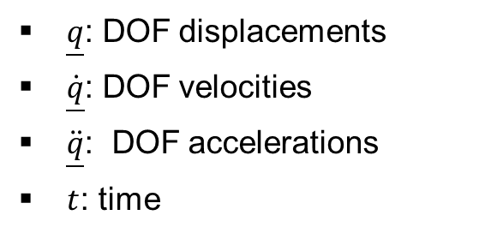
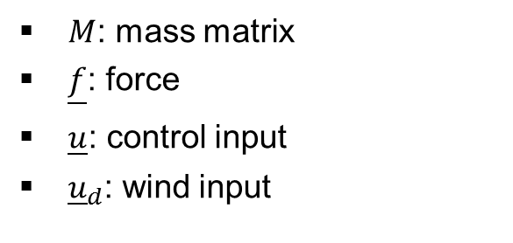
Nonlinear Aerodynamics
AeroDyn
An aero-elastic simulation code (by NREL) to predict the aerodynamics
Input: steady or turbulent wind file
Output: force and moment on the turbine components
Nonlinear aero-elastic equations of motion of wind turbine system
$M$: mass matrix
$\underline{f}$: force
$\underline{u}$: control input
${\underline{u}}_{d}$: wind input
$\underline{q}$: DOF displacements
$\underline{\dot{q}}$: DOF velocities
$\ddot{\underline{q}}$: DOF accelerations
$t$: time
Notes:
In order to get a proper model to design the controller,
we use the AeroDyn code to….. The input are wind file, turbine geometry, airfoil files and so on.
The output is force ……
The nonlinear …..is in this from. q .. F.. U.. Ud..
M is mass matrix, it is related to q, u, t that is because of different coordinates we use.
//which is independent, wind speed, pitch angle
which is not: rotor speed

Slide 10
Model Linearization
FAST (Fatigue, Aerodynamics, Structures, Turbulence)
FAST code (by NREL) used for simulating the coupled dynamic responses of wind turbines
State space representation
Numerically linearize the equation by perturbing (∆) each variable about their respective operating points (op):
linearization
Notes:
Then we can link it to FAST code to do linearization
FAST numerically …and substituting it to the previous nonlinear equation of motion
after Taylor series expansion. We could get the standard linearized form
And this is the state space form, delta ud is disturbance from the wind speed at operating point
So we have got the linearized model
(DspCis the displacement output matrix VelCis the velocity output matrix)

Slide 11
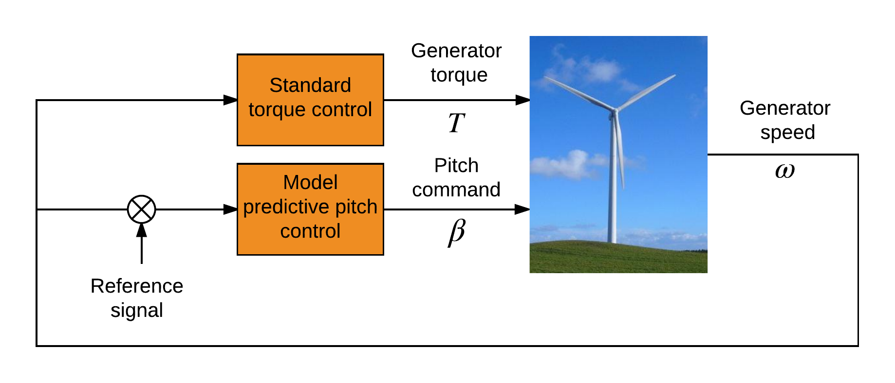
Control Architecture
-
Torque control: Standard torque control
Pitch control: Model predictive control
Yaw control: Not involved
Notes:
The yaw control is not involved, similar to other studies.

Slide 12
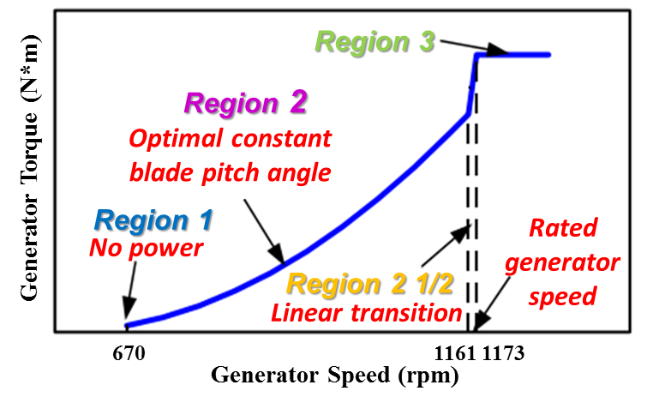
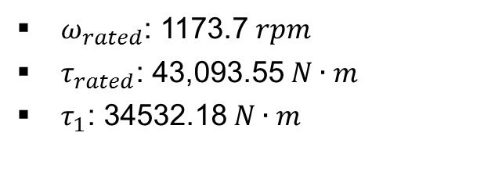
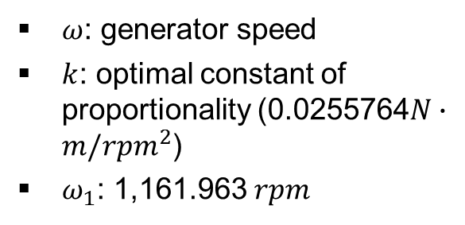
Standard Torque Control
Generator torque controller
$ω$: generator speed
$k$: optimal constant of proportionality (0.0255764$N∙m/{rpm}^{2}$)
$ω_{1}$: 1,161.963 $rpm$
$ω_{rated}$: 1173.7 $rpm$
$τ_{rated}$: 43,093.55 $N∙m$
$τ_{1}$: 34532.18 $N∙m$
Notes:
That is the overall torque control in 3 regions…..
Actually the torque controller can be designed with adaptive control or sliding mode control to achieve better performance in the literature.
Here for this baseline controller,
In Region 1, torque is 0.
In region 2 ,torque is a function of generator speed. To maintain a constant optimal tip speed ratio
In region 2 and a half, it is a ……
In region 3 ,the torque is held at rated value

Slide 13
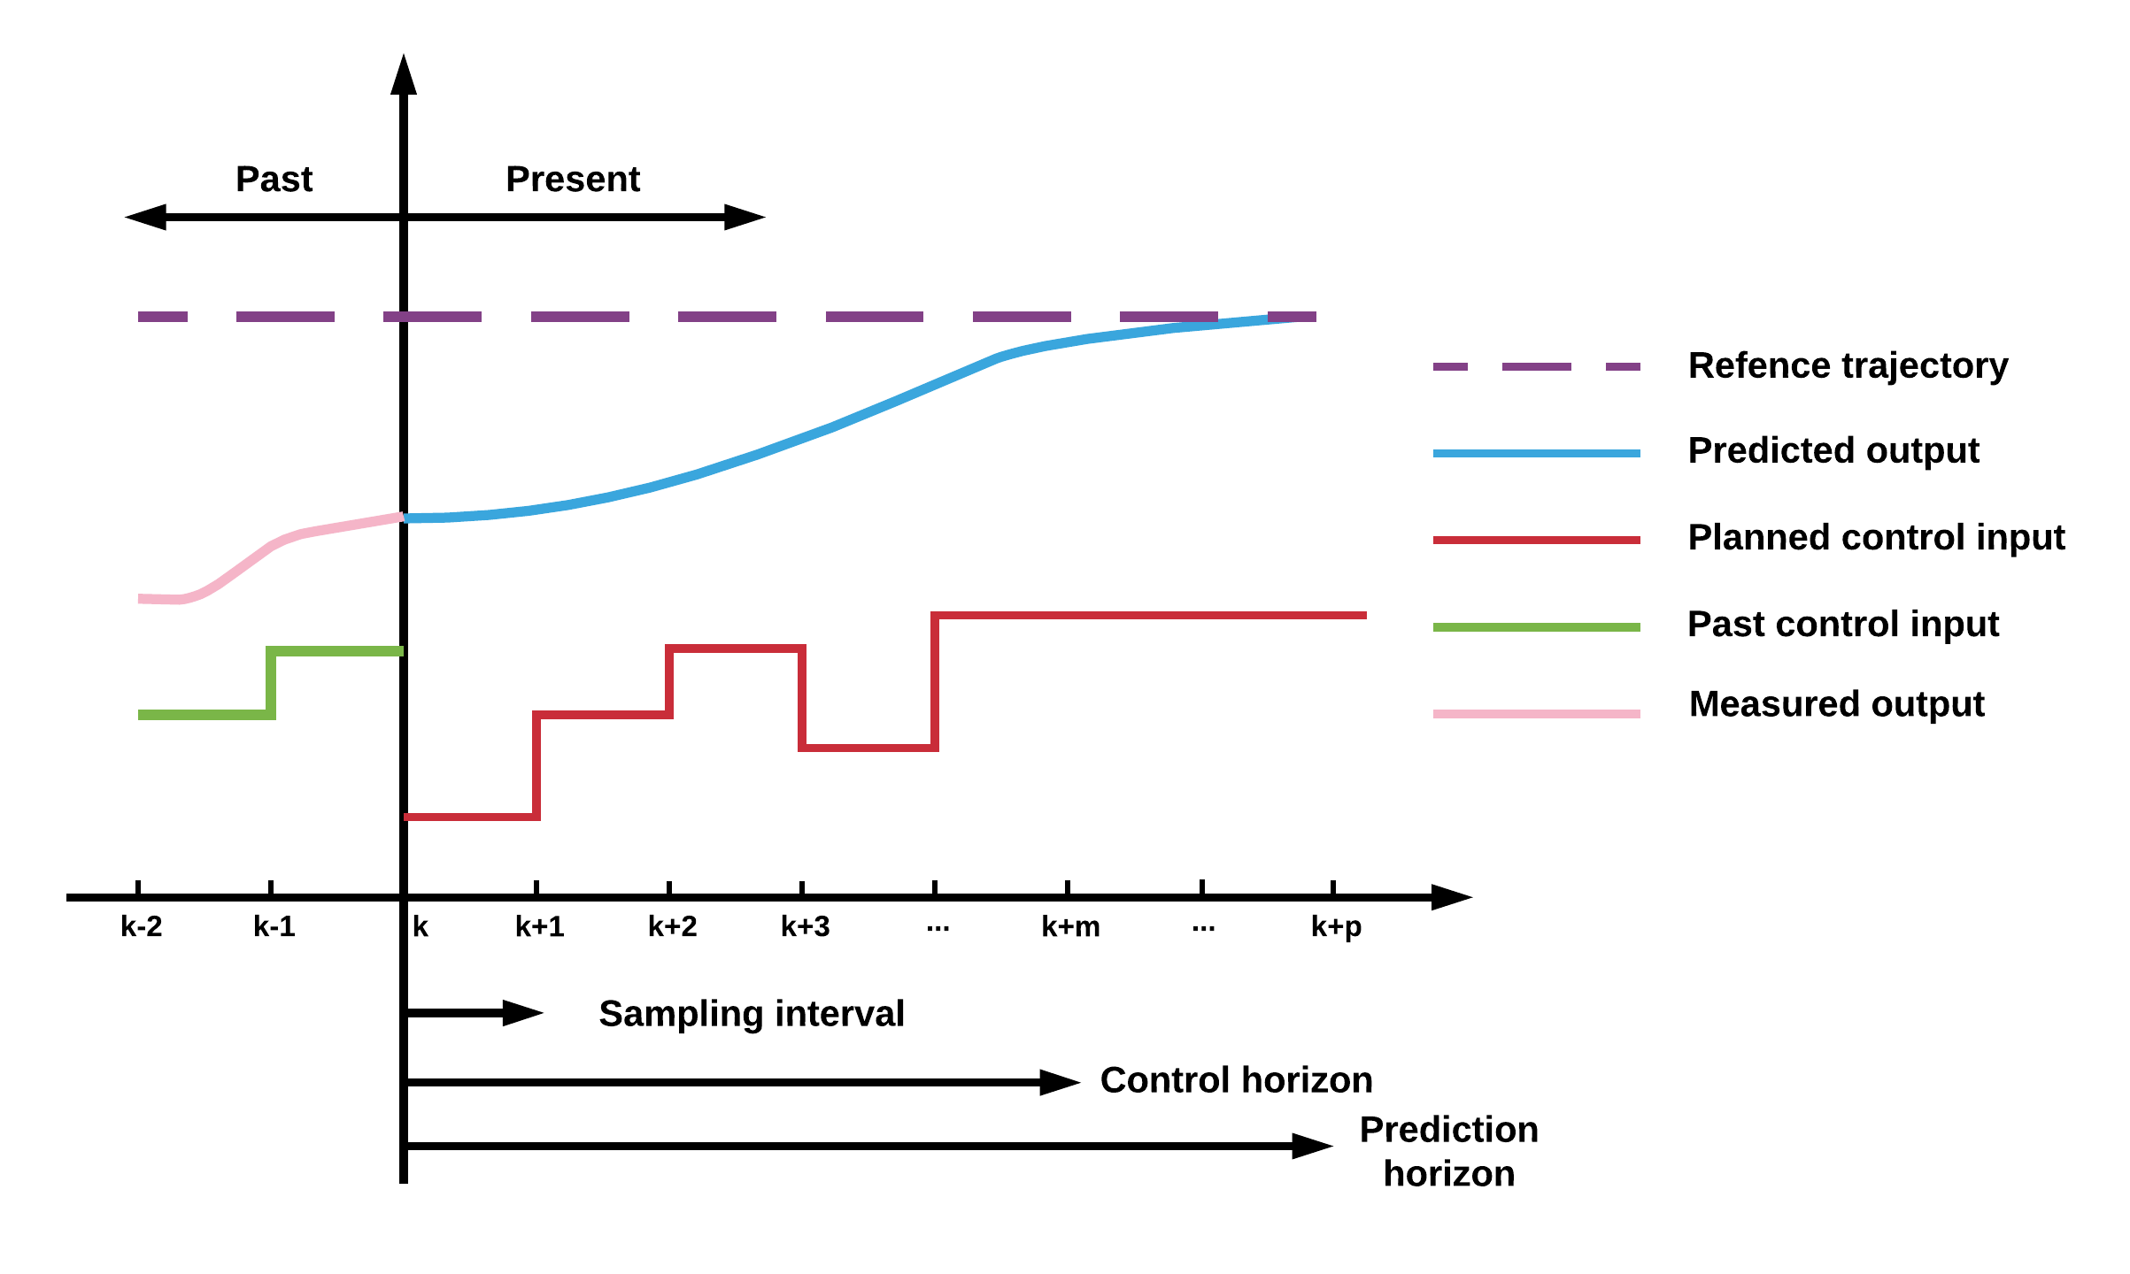

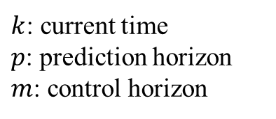
Model Predictive Controller (MPC)
$k$: current time
$p$: prediction horizon
$m$: control horizon
Model predictive control (MPC): regulatory controls that use an explicit dynamic model of the response of process variables to changes in manipulated variables to calculate control “moves”
Control moves are intended to force the process variables to follow a pre-specified trajectory
Notes:
This is an overview of model predictive controller, when we talk about MPC ,we are talking about using..
We have our manipulated variables , the planned control input
and we also have our process, the measured output and the past control input. We want to drive the predicted output close to the reference trajectory
What we are going to do is based on the information at time k to calculate the control input in the next step

Slide 14
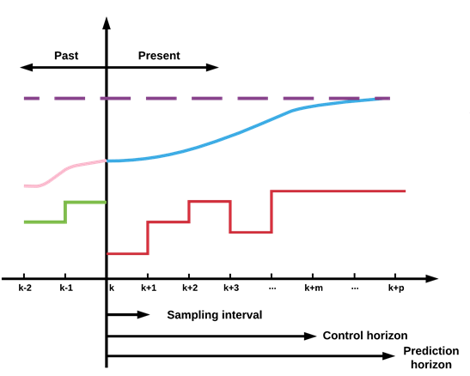
Model Predictive Controller (MPC)
Predicted outputs
Cost function
Notes:
In order to predict the outputs, we need a prediction model. The model can be linear , nonlinear.. First principle model and hybrid models.. Here we use linear model from FAST.
The predicted outputs are a function of current state, past control input, future control input and unmeaured disturbances. The disturbance can be estimated by the Kalman filter.
What are we going to do next is using a cost function which can penalize the tracking error and control effort.

Slide 15
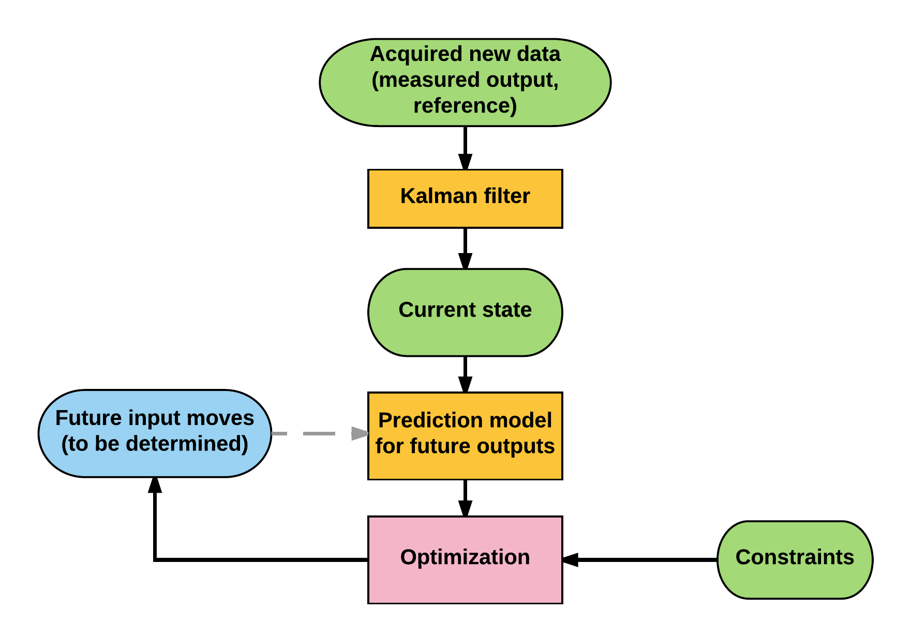
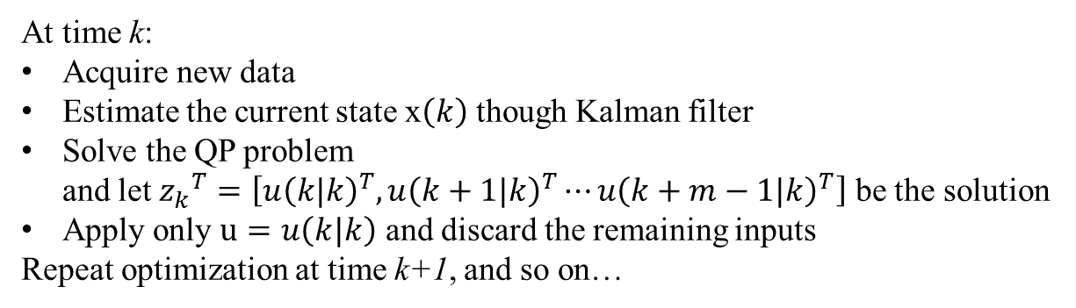
Model Predictive Controller (MPC)
Optimal solution
Find
to minimize
subject to
Optimization steps:
At time k:
Acquire new data
Estimate the current state x$\left(k\right)$ though Kalman filter
Solve the QP problem
and let ${z_{k}}^{T}=\left[{u\left(k|k\right)}^{T},{u\left(k+1|k\right)}^{T}⋯{u\left(k+m−1|k\right)}^{T}\right]$ be the solution
Apply only $u=u\left(k|k\right)$ and discard the remaining inputs
Repeat optimization at time k+1, and so on…
Notes:
So the problem is to find an …..that is the control sequences of next m steps based on the information at time k
Upper and lower limits
Take the first move out of calculated control sequences to implemete. At next time step, everything shifts over by one, and recalculate moves based on the measurements at th samp
Since it is on-line optimization, the controller can reject the Unmeasured disturbances , and the influence the process model errors can be taken care of

Slide 16
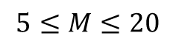
Selection of Design Parameters
Prediction horizon, p
Larger p results in less aggressive control action
Control horizon m
Larger m makes the controller more aggressive and increase computational effort, typically
$$5≤M≤20$$
Weighting matrices Q and R
Diagonal matrices with larger elements corresponding to most important variables

Slide 17
Outline
Background
Research Objective
Approach
Case Analysis
Concluding Remarks
Notes:
Next we will present the case study results

Slide 18
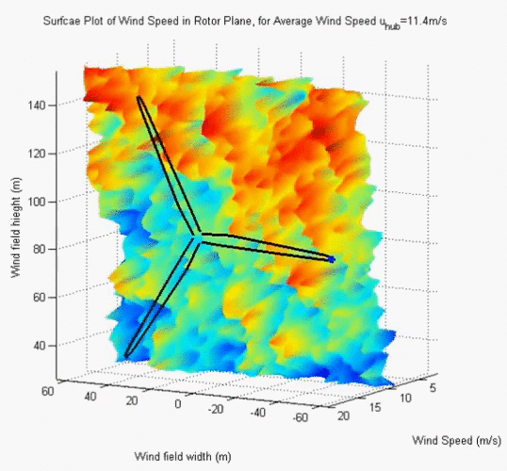
Case Study: Nonlinear plant
Case study:
Test wind turbine
NREL offshore 5-MW baseline
wind turbine
Degree of freedom (DOF)
16 DOFs*
Turbulent wind field
Simulation time
Run time: 0 to 600 s
Integration step size: 0.0125 s
Blade pitch limit and pitch rate limit ^{[1]}
Minimum/maximum blade pitch: 0 degree / 90 degree
Maximum absolute blade pitch rate: 8 degree/s
Source:https://www.youtube.com/watch?v=h4KidjcDDis
[1] Jonkman et al., 2009, National Renewable Energy Laboratory, Golden, CO.
*First flapwise blade mode (3 blades), second flapwise blade mode (3 blades), first edgewise blade mode (3 blades), drivetrain rotational-flexibility, generator, yaw, first fore-aft tower bending-mode, second fore-aft tower bending-mode, first side-to-side tower bending-mode, second side-to-side tower bending-mode.
Notes:
The wind speed on each segment of blade is going to change with time.

Slide 19
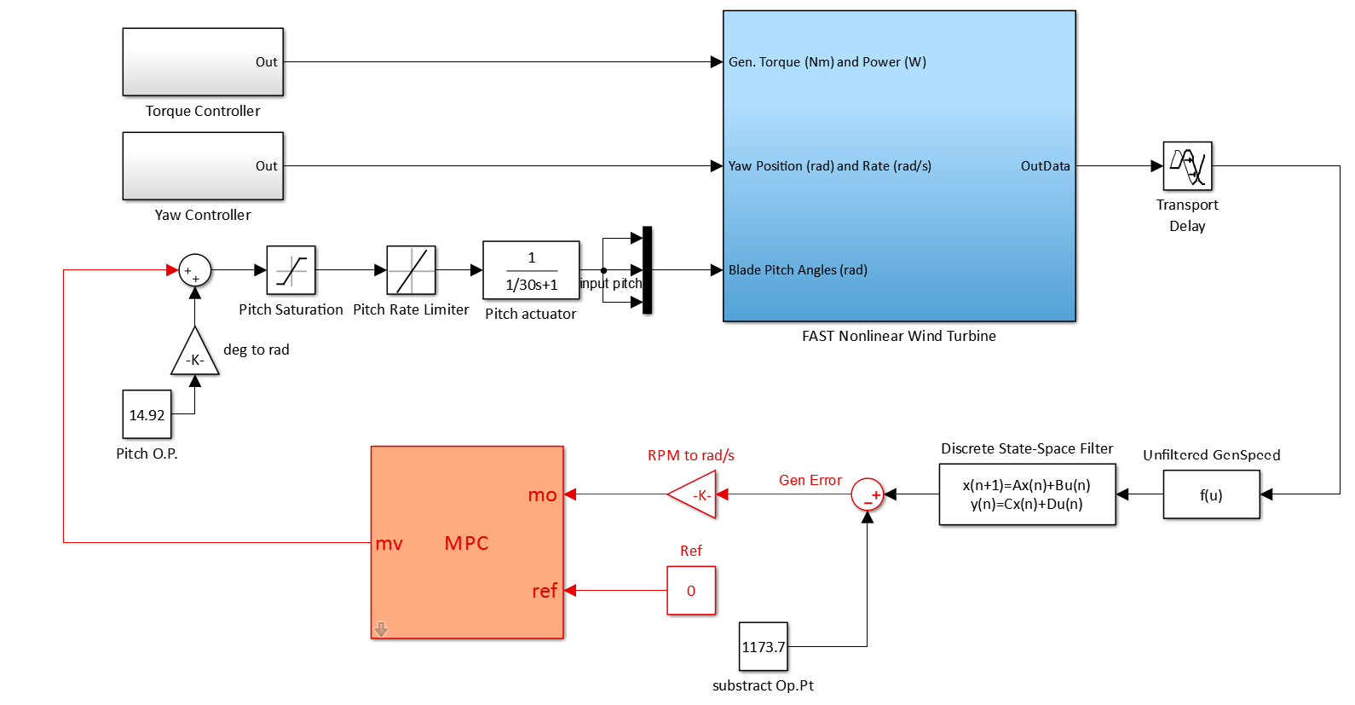
Nonlinear plant model

Slide 20
Switching Region Performance
Wind fields:
11 m/s, 12 m/s, 13 m/s
Results:
Power: Nearly same
Speed : better
Tower fore-aft loads: reduced
Tower side-side loads: mixed
Blade edgewise loads: nearly same
Blade flapwise loads: reduced
Pitch actuator: reduced

Slide 21
Region 3 Performance
Wind fields:
16 m/s, 18 m/s, 20 m/s
Results:
Power: Nearly same
Speed : better
Tower fore-aft loads: increased
Tower side-side loads: increased
Blade edgewise loads: nearly same
Blade flapwise loads: increased
Pitch actuator: increased

Slide 22
Concluding Remarks
A general model predictive controller tailored for wind turbine is developed;
Optimization of multiple objectives in the switching region and Region 3;
Switching region: loads on blades and tower can be reduced, actuator usage is reduced and power is nearly same;
Region 3: loads and actuator usage are deteriorated.
This research is supported by NSF under grant CMMI – 1300236

Slide 23
The End
Questions?
Notes:
Thank you

Slide 24
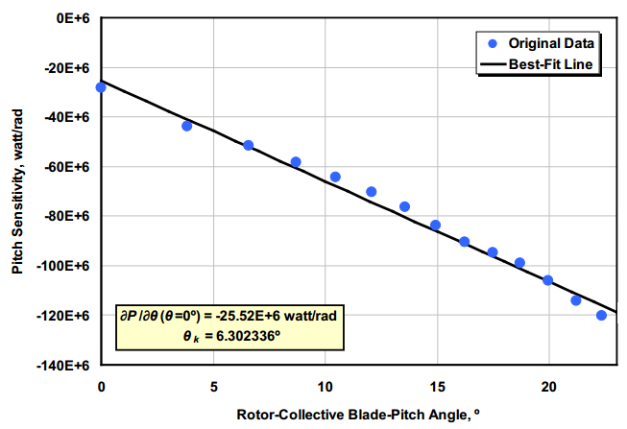
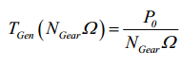
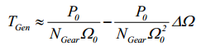
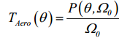
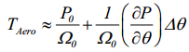
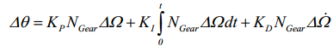
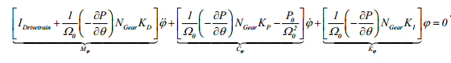
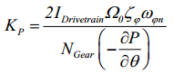
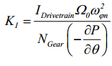
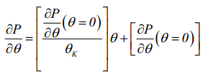
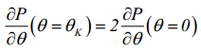
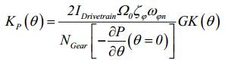
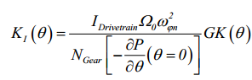
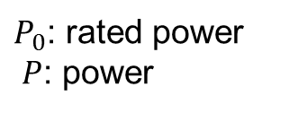
Gain Scheduling PID
$P_{0}$: rated power
$P$: power

Slide 25
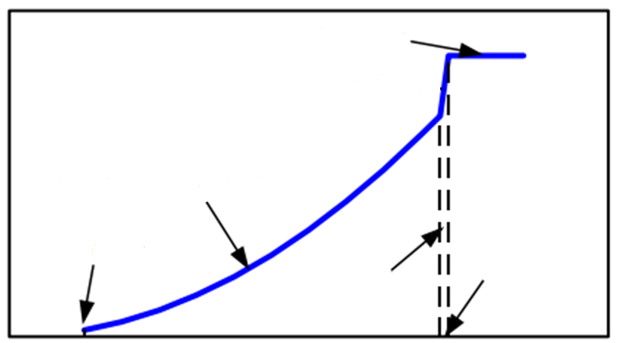

Standard Torque Control
TSR:$λ=\frac{ωR}{v}$
Generator Torque (N*m)
Region 3
Region 2 standard torque control
Region 2
Optimal constant blade pitch angle
Region 1
Rated generator speed
No power
Region 2 1/2
Linear transition
670
1161
1173
Generator Speed (rpm)
Notes:
In Region 2, the control objective is to maximize the power capture. We use torque control to achieve it. Let us look at the Cp surface. We can see the maximum value is in pitch angle 0 tip speed ratio 7.5.
That is make the tip speed ratio be the optimal value, at the optimal pitch angle.
Then we should let the rotor speed track the wind speed. Here the pitch control is disabled, then we control torque to change rotor speed.
power Per second

Slide 26
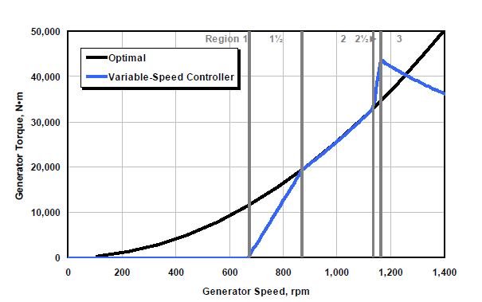
Region 2 Torque Control

Slide 27
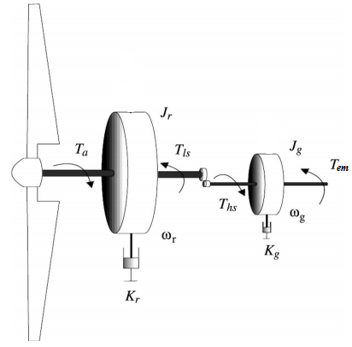
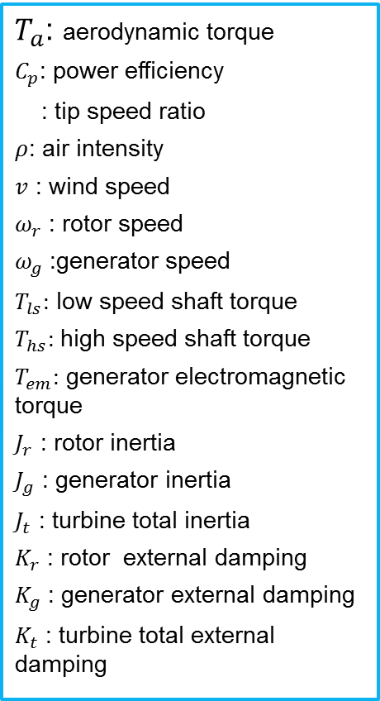
Simple Model
Aerodynamic torque
$T_{a}$: aerodynamic torque
$C_{p}$: power efficiency
: tip speed ratio
$ρ$: air intensity
$v$ : wind speed
$ω_{r}$ : rotor speed
$ω_{g}$ :generator speed
$T_{ls}:$ low speed shaft torque
$T_{hs}:$ high speed shaft torque
$T_{em}:$ generator electromagnetic torque
$J_{r}$ : rotor inertia
$J_{g}$ : generator inertia
$J_{t}$ : turbine total inertia
$K_{r}$ : rotor external damping
$K_{g}$ : generator external damping
$K_{t}$ : turbine total external damping
Rotor Dynamics and
generator dynamics
Gearbox ratio
Notes:
In most of the literature, a simple model is adopted to design control method in order to get better speed regulation.
The aerodynamics… is a function of power efficiency, wind speed and rotor speed, it is highly nonlinear.
Assume the low speed shaft is rigid, the rotor dynamics and generator dynamics can be expressed as…
As the low speed shaft torque and HSS torque satisfy gearbox ratio relationship, finally we could get a simple equation of motion.
We can control the electromagnetic torque to track the generator speed. But it is hard to use this model to adjust blade pitch angle to achieve load reduction. Because here the pitch angle is contained in the nonlinear term Cp.

Slide 28
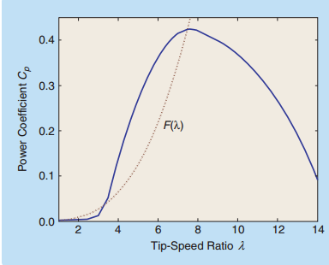

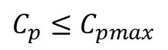
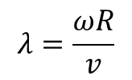

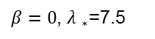
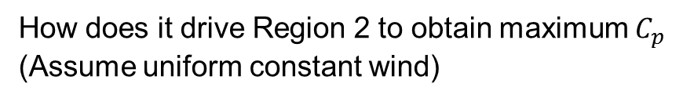
Region 2 standard torque control
$$λ=\frac{ωR}{v}$$
How does it drive Region 2 to obtain maximum $C_{p}$ (Assume uniform constant wind)
$β=0$, ${λ }_{∗}$=7.5
The curve (dotted line)
The solid line $Cp(β=0)$
$λ>{λ }_{∗}$, $\dot{ω_{r}}<0$, rotor will decelerate towards $λ={λ }_{∗}$
$C_{p}≤$ $C_{pmax}$
, , $\dot{ω_{r}>}0\text{, }λ{<λ }_{∗}$, it will accelerate to ${λ }_{∗}$
, $\dot{ω_{r}<}0$ rotor speed will slow to zero

Slide 29
Torque Control
Generator torque controller
$ω$: generator speed
$k$: optimal constant of proportionality (0.0255764$N∙m/{rpm}^{2}$)
$ω_{1}$: 1,161.963 $rpm$
$ω_{rated}$: 1173.7 $rpm$
$τ_{rated}$: 43,093.55 $N∙m$
$τ_{1}$: 34532.18 $N∙m$
Notes:
That is the overall torque control in 3 regions…..
Actually the torque controller can be designed with adaptive control or sliding mode control to achieve better performance in the literature.
Here for this baseline controller,
In Region 1, torque is 0.
In region 2 ,torque is a function of generator speed. To maintain a constant optimal tip speed ratio
In region 2 and a half, it is a ……
In region 3 ,the torque is held at rated value

Slide 30
Bode of PID
Notes:
What Q cut-off freq. means? Reject the disturbance smaller than this?
0.9952 . Smaller than this, it diverge

Slide 31
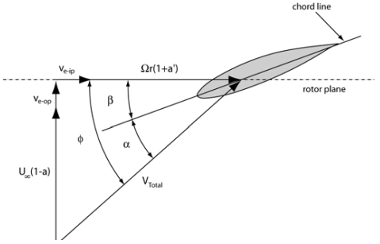
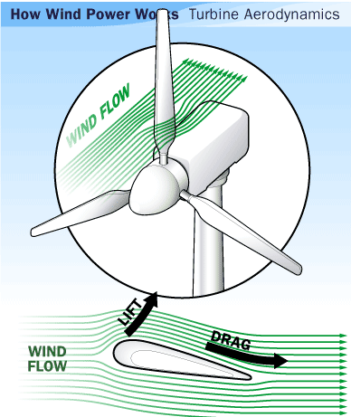
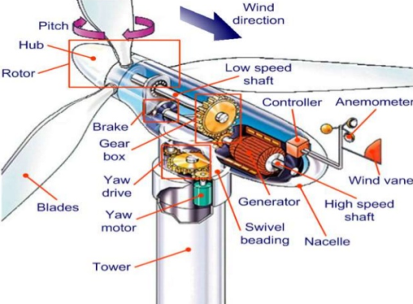
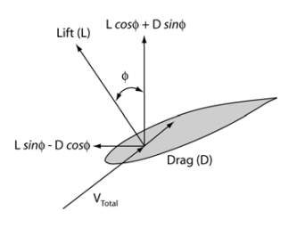
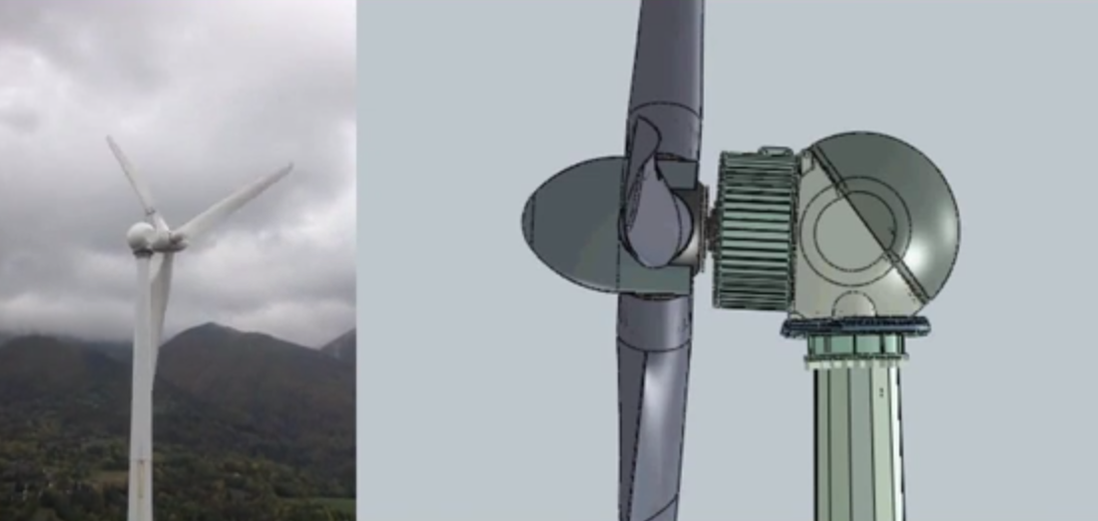
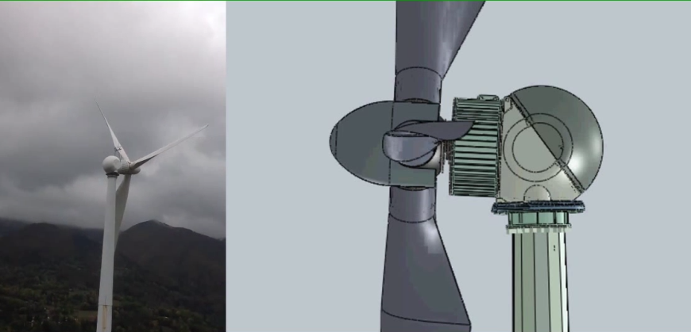

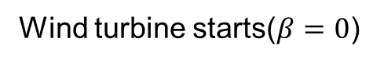
Pitch angle
Low speed shaft horizontal axis
rotor plane
Wind turbine starts($β=0$)
Wind turbine stops($β=$90)
Notes:
Pitch angle is the angle between chord line and rotor plane

Slide 32

Turbulent wind field

Slide 33


Flapwise shear force and moment
Flapwise shear force at the blade root:
Directed along the $x_{b,i}$ axis (kN)
Flapwise moment at the blade root :
About the $y_{b,i}$ axis (kN*m)
Wind
Notes:
Perpendicular
parallel

Slide 34

Pitch Sensitivity
Blade-pitch sensitivity
aerodynamic property of the rotor that depends on the wind speed, rotor speed, and blade-pitch angle
perturb the rotor collective blade pitch angle at each operating point and measure the resulting variation in aerodynamic power
Table Sensitivity of Aerodynamic Power to Blade Pitch in Region 3
Wind speed (m/s) | Rotor Speed (rpm) | Pitch Angle (deg) | $\frac{∂θ}{∂x}$ (watt/rad)
11.4-Rated | 12.1 | 0.00 | -28.24E+6
12.0 | 12.1 | 3.83 | -43.73E+6
13.0 | 12.1 | 6.60 | -51.66E+6
14.0 | 12.1 | 8.70 | -58.44E+6
15.0 | 12.1 | 10.45 | -64.44E+6
16.0 | 12.1 | 12.06 | -70.46E+6
17.0 | 12.1 | 13.54 | -76.53E+6
18.0 | 12.1 | 14.92 | -83.94E+6
19.0 | 12.1 | 16.23 | -90.71E+6
20.0 | 12.1 | 17.47 | -94.71E+6
21.0 | 12.1 | 18.70 | -99.04E+6
22.0 | 12.1 | 19.94 | -105.90E+6
23.0 | 12.1 | 21.18 | -114.30E+6
24.0 | 12.1 | 22.35 | -120.20E+6
25.0 | 12.1 | 23.47 | -125.30E+6

Slide 35

Torque control: Choose the appropriate stator current according to the difference of reference torque and actual torque
Control structure of a permanent magnet synchronous generator system for use in wind turbines
Notes:
Stator coils
Rotor magnet

